Slide 1

bUS management system Group no:15
PRESENTED BY: 1.Muhammad Talha …………………………………………………….193 2.Hussain Muhay Ud Din……………………………………………508

Slide 2
INTRODUCTION
The project is a Bus Management System designed to manage bus records and booking systems. It includes functionalities for -adding -viewing, -updating, -deleting bus records, -managing bus routes. Additionally, it supports booking seats on buses and handling booking records.

Slide 3
FUNCTIONS OF PROJECT
1
2
Booking Management:
Book seats on buses
View bus seat details
Search booking records
Update booking records
Delete booking records
Show all booking records
Bus Management:
Add new bus records
View single or all bus details
Update bus records
Delete bus records
View bus routes

Slide 4
BUS MANAGEMENT
Add a Bus Record: Navigate to the "Add Bus Record" option, input the bus details, and ensure no duplicate records exist.
Viewing Bus Details:
Users can view details of a single bus by entering the bus number.
The system can also display a list of all buses with their details. Update Bus Details: Select a bus to update and input new details.
Delete Bus Record: Select and delete a bus record.
Bus Routes:
This section displays predefined routes for five different locations (Lahore, Faisalabad, Islamabad, Rawalpindi, Multan).
Users can select a route to view its details, which includes departure and arrival times for various destinations.

Slide 5
Classes:
ManagementSystem (Abstract base class)
Bus (Derived class for bus management)
Booking_System (Derived class for booking management)

Slide 6
Methods in Bus Class:
menu()
new_bus()
bus_details()
single_bus()
all_buses()
update_bus()
del_bus()
bus_route()

Slide 7
Methods in Booking_System Class:
menu()
booking()
bus_seatsdetails()
search_booking()
update_booking()
del_booking()
show_booking()

Slide 8
ManagementSystem (abstract)
|
|--> Bus
| |- menu()
| |- new_bus()
| |- bus_details()
| |- single_bus()
| |- all_buses()
| |- update_bus()
| |- del_bus()
| |- bus_route()
|
|--> Booking_System
|- menu()
|- booking()
|- bus_seatsdetails()
|- search_booking()
|- update_booking()
|- del_booking()
|- show_booking()

Slide 9
CONCEPTS USED
Inheritance:
ManagementSystem is a base class .
Bus and Booking_System inherit from ManagementSystem and implement the menu() method.
Polymorphism:
The menu() method in the base class is a pure virtual function
Data Abstraction:
Implementation details of bus and booking management are hidden from the user through class interfaces.
two derived classes Bus and Booking_System

Slide 10
Loops:
while loops are used in file reading and handling input to retry on invalid entries .
do-while loop is used in booking() method for seat booking process.
Conditional Statements:
if-else statements are used to check conditions such as file existence and duplicate records.
switch statements are used for menu selection in both Bus and Booking_System classes.
File Handling:
The system reads from and writes to text files to persist bus and booking records.

Slide 11
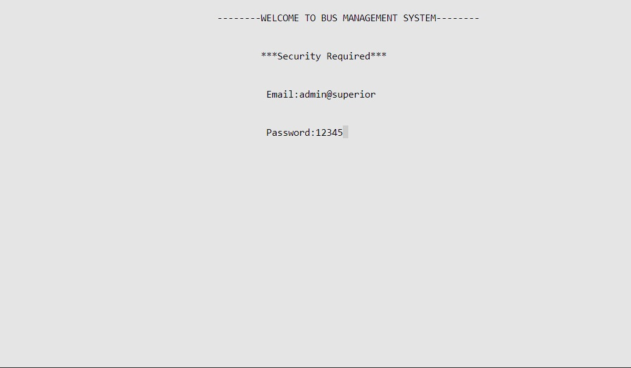
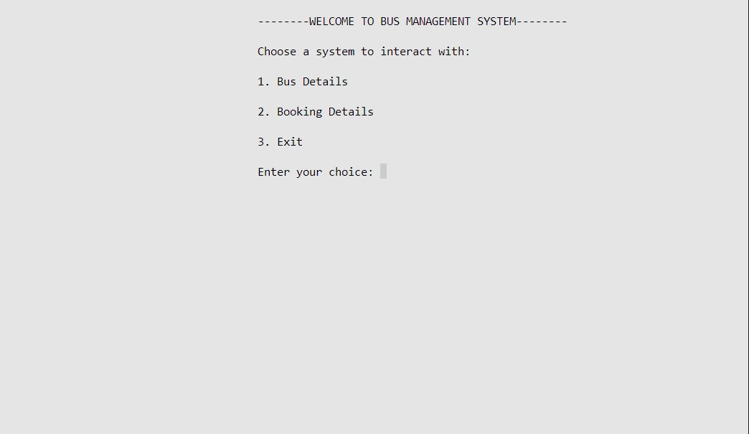
1
OUTPUT :
2

Slide 12
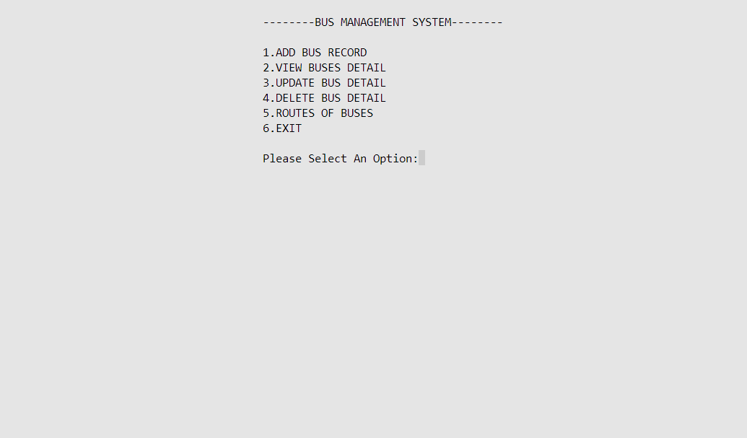
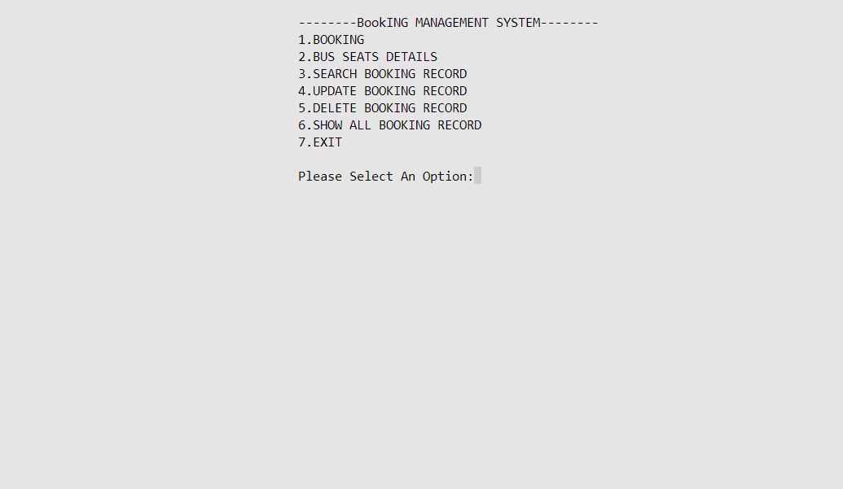
BUS DETAILS
BOOKING DETAILS

Slide 13
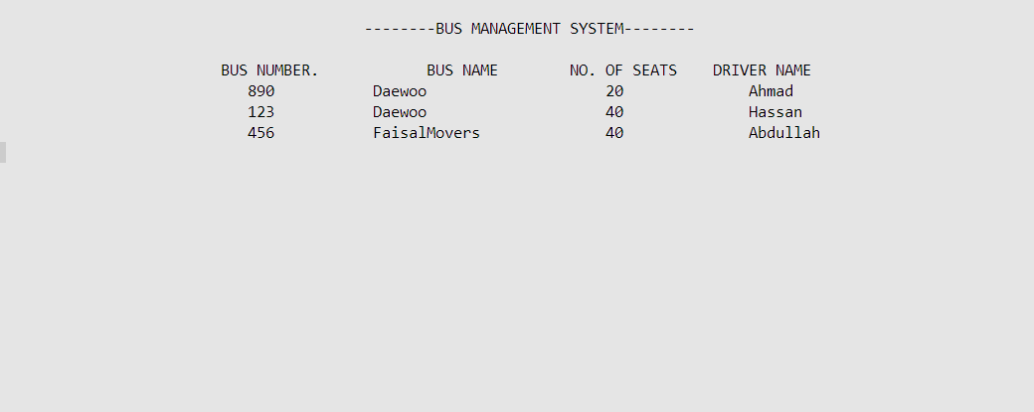
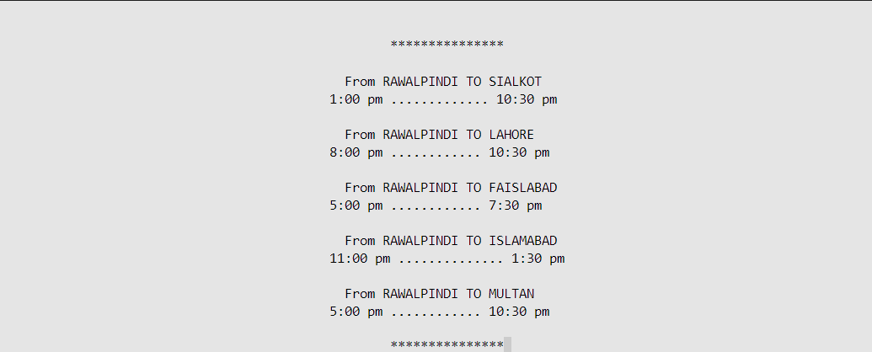
ROUTES OF BUSES
VIEW BUSES DETAIL

Slide 14
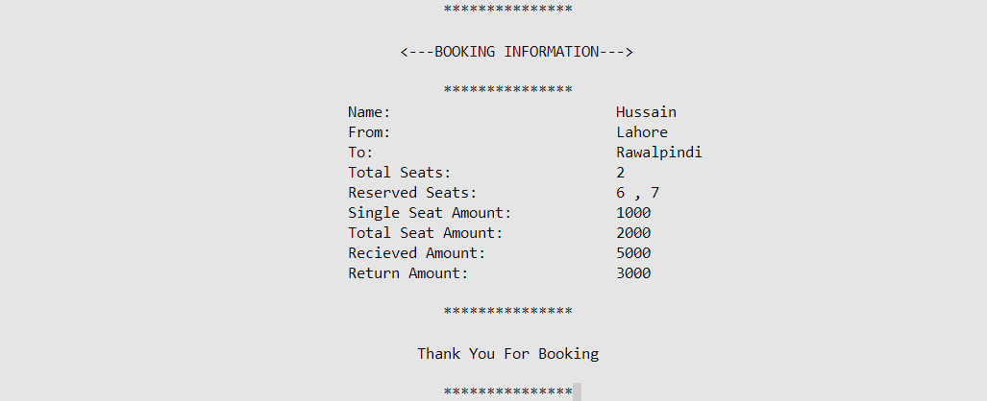
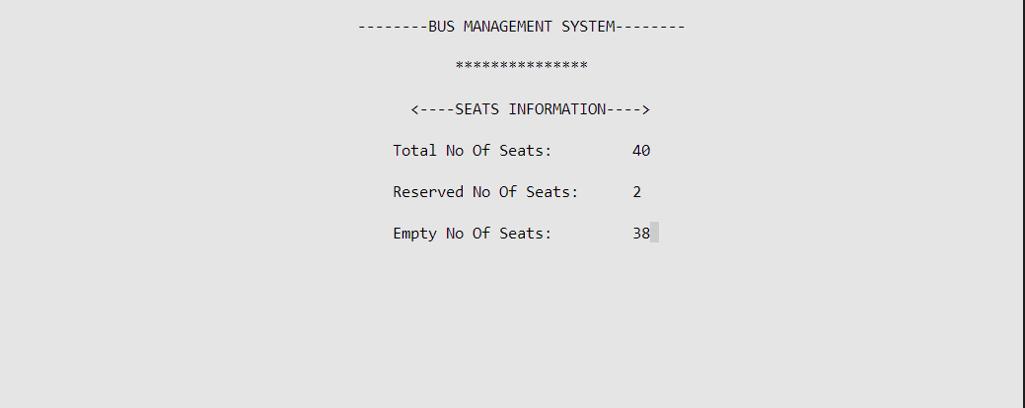
BUS SEATS DETAILS
RESERVATION SLIP FROM BOOKING

Slide 15


THANK YOU”

